Slide 1
World of Point Clouds
By Manash J Konwar

Slide 2




Table of Contents
01
03
OVERVIEW
EXPLORATION
What are Point Clouds?
LIDAR
Present Infrastructure
Applications around Point Clouds
Why Point Clouds?
What is Neural Network?
Components of NN
Current Solution
Datasets Utilized
Dash Integration
02
04
POINTNET
NEXT STEPS
Overall Architecture
Vanilla Pointnet / Transformation Network
Features of Pointnet
Usage of Pointnet
Frustum Pointnet/ Voxel Pointnet
Real Time 3D Object Detection
Important Links
Q&A Session

Slide 3
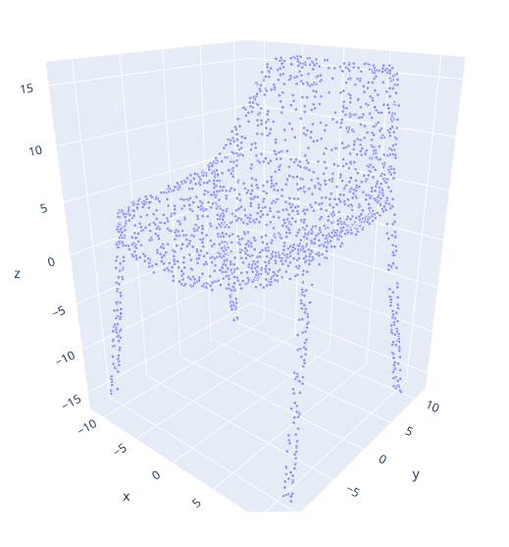
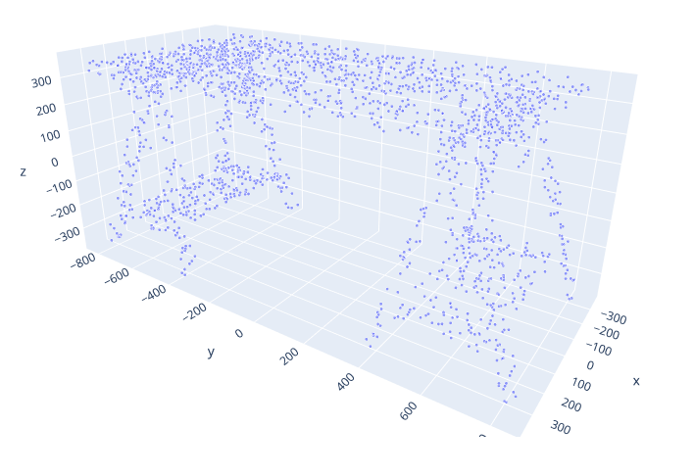
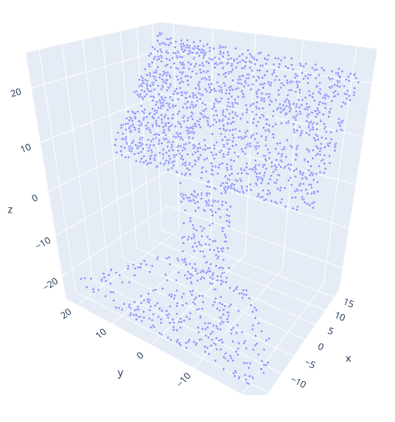
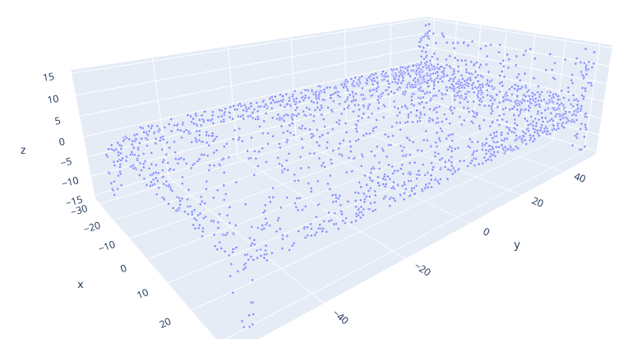
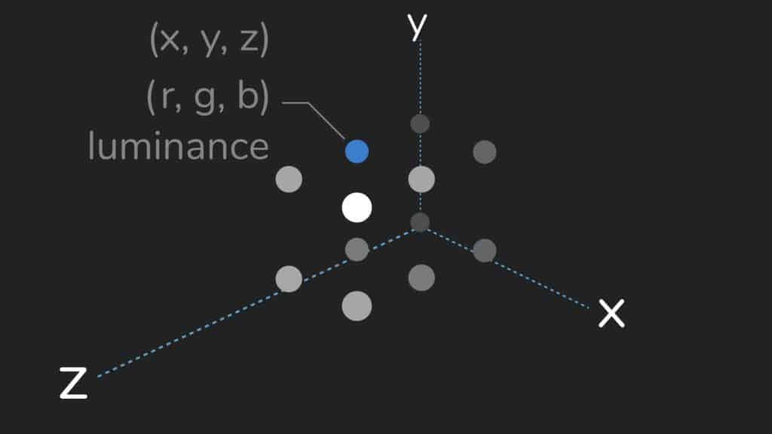
Overview
What are Point Clouds?
Point clouds are essentially the simplest form of 3D models. They are collections of individual points plotted in 3D space.
Each point contains several measurements, including its coordinates along the X, Y, and Z-axes, and sometimes additional data such as a color value, which is stored in RGB format, and luminance value, which determines how bright the point is.

Slide 4
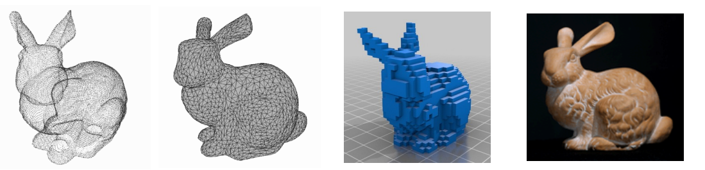
Overview
What are Point Clouds?
3d Representations:
Point Clouds
Meshed Object
Volumetric
RGB Projection

Slide 5
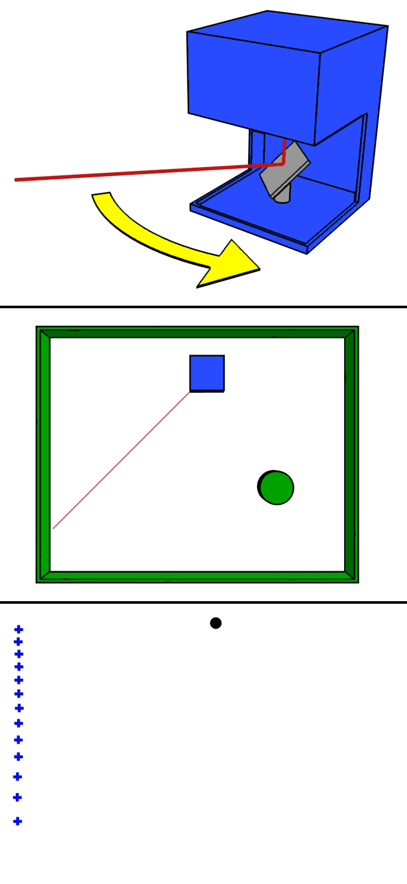
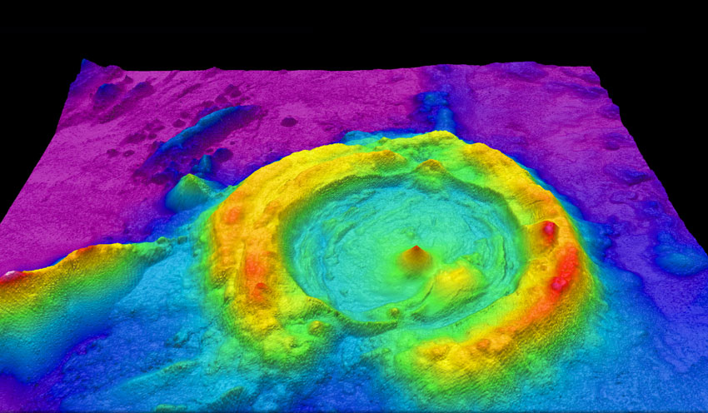
Overview
LIDAR
LiDAR (Light Detection and Ranging) is a method used to generate accurate 3D representations of the surroundings, and it uses laser light to achieve this. Basically, the 3D target is illuminated with a laser light (a focused, directed beam of light) and the reflected light is collected by sensors. The time required for the light to reflect to the sensor is calculated.
Applications of LiDAR:
Moving Robot uses LiDAR to create a 3d map of its surroundings
In Archeology, LiDAR is used to create 3d renderings of 2d scans of artifacts
In Geology, LiDAR can be used to render high quality 3d maps of inaccessible terrains, ocean floors, etc.

Slide 6
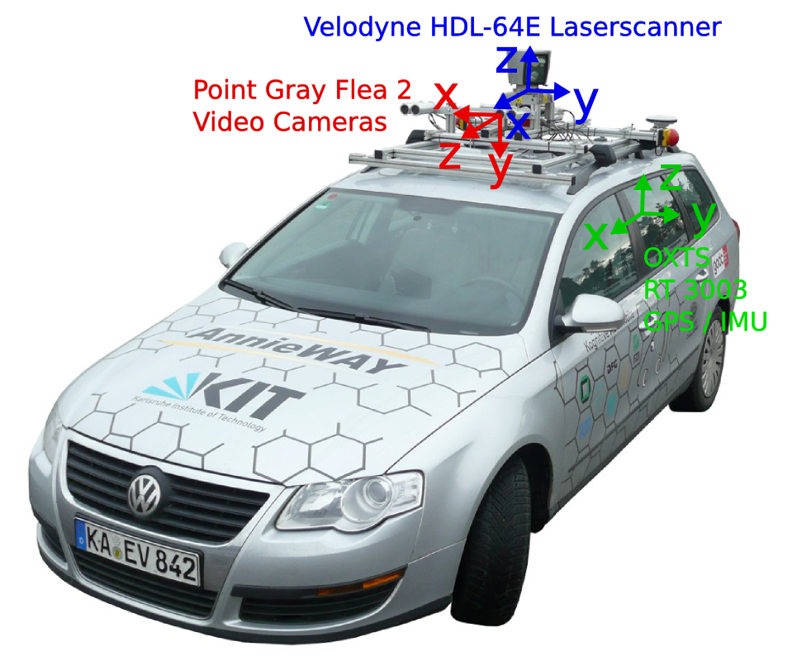
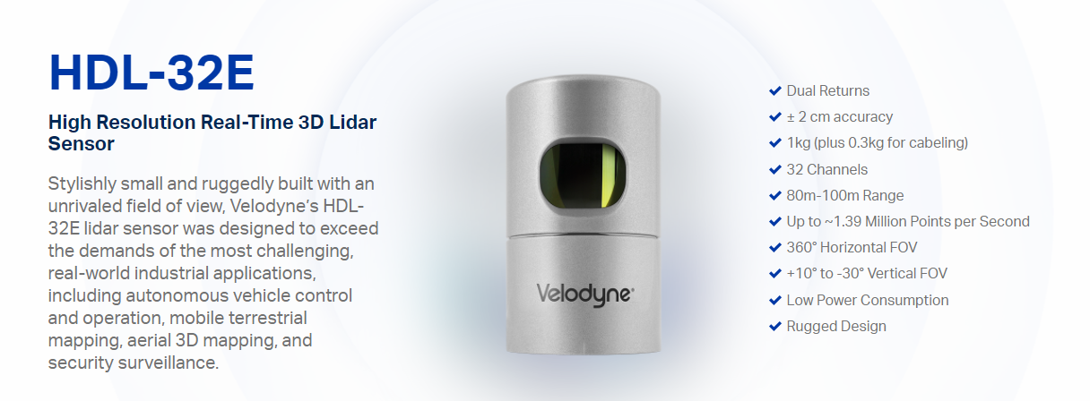
Overview
Present Infrastructure
Most Sensors which can generate LiDAR data points are build by the organization called as “VELODYNE LIDAR”
Its a very expensive setup however this organization provide all the necessary hardware and even software platforms to integrate them all together.

Slide 7
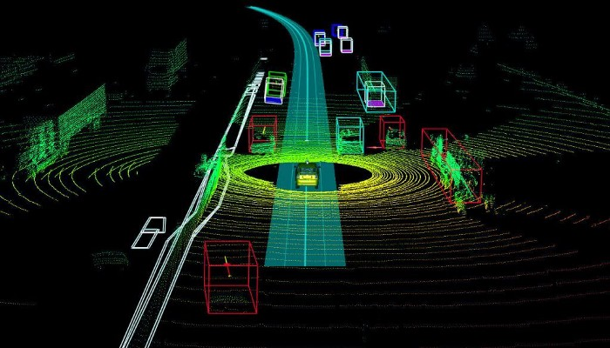
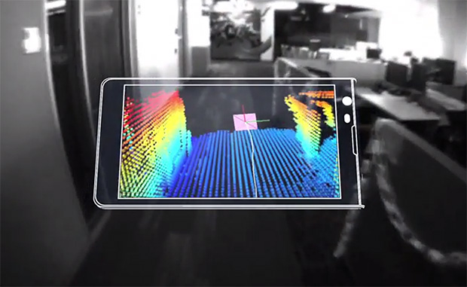
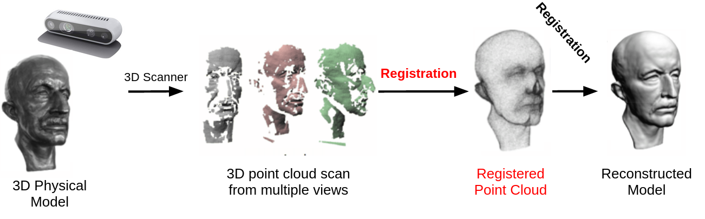
Overview
Applications around point clouds
Robot Perception / Autonomous driving
Augmented Reality
Shape Design

Slide 8
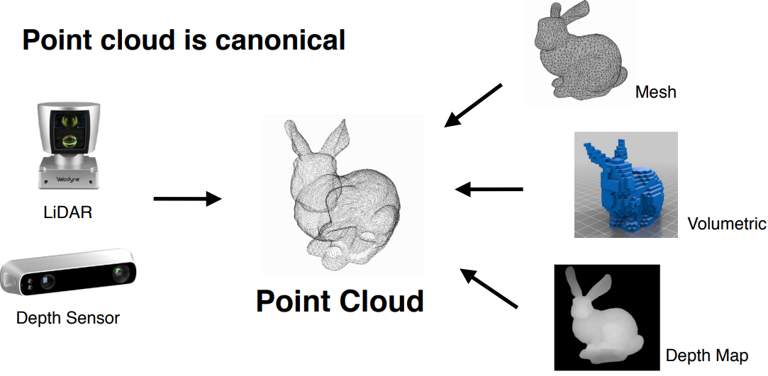
Overview
Why Point Clouds?
Point Clouds are the rawest form of sensor data
They are highly canonical in nature

Slide 9
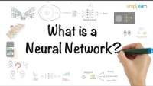
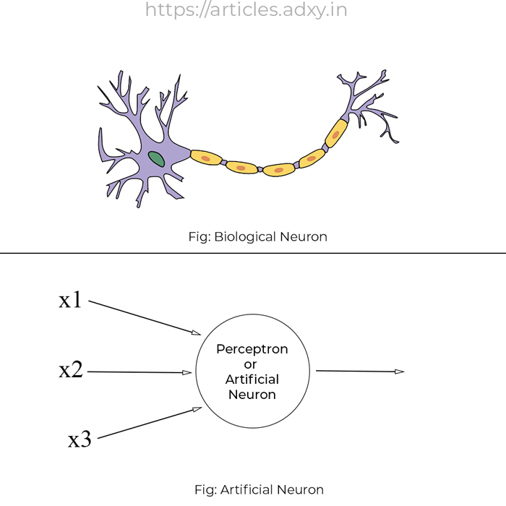
Overview
What is Neural Network?

Slide 10
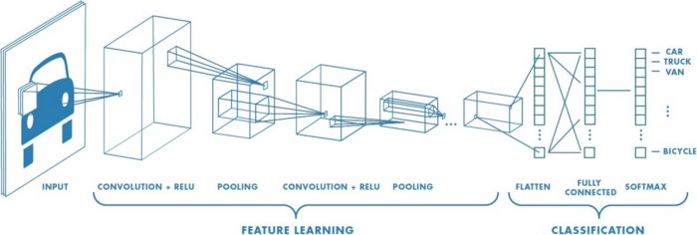
Overview
Components of CNN
Convolution Layer: Helps to understand local features among pixels thus exploiting the spatial correlation among these pixels.
Pooling Layer: Helps to reduce the dimensionality of the feature maps generated in the convolutional layer thus reducing the amount of computation required.

Slide 11
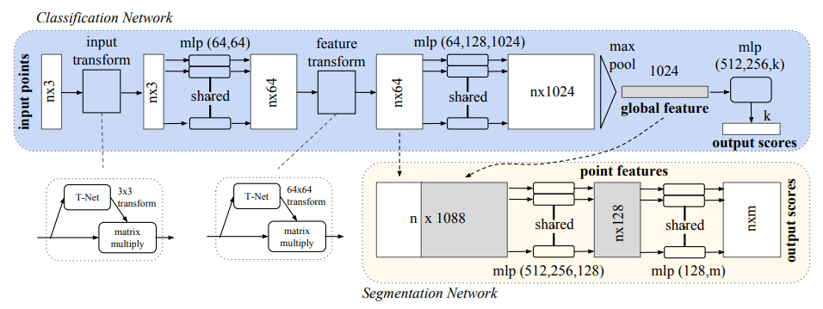
Pointnet
Overall Architecture
Challenges with Point Clouds:
Permutation Invariance: Since the points in the point cloud is unstructured, a scan of N points has N! different permutations. The data processing must be invariant to different permutated representations of Point Cloud.
Transformation invariance: The classification and segmentation output can not be impacted by different transformations like rotation and translation.
Interaction b/w different Points: The connections between neighboring points often carries useful information. Therefore, each point should not be treated in isolation. These interactions can play a more useful role in segmentation than classification.

Slide 12
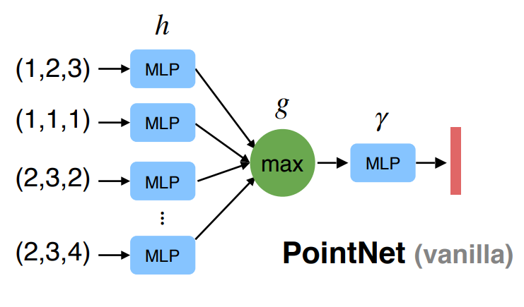
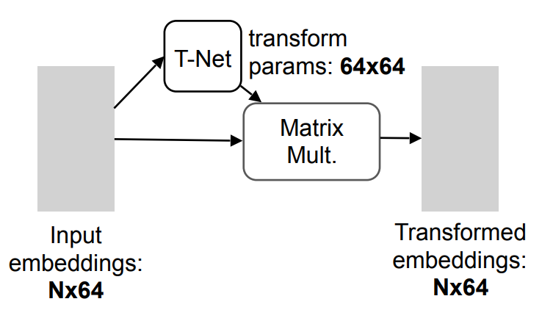
Pointnet
Vanilla Pointnet
Resolves Permutation Invariance by making use of a symmetric function
Vanilla Pointnet is achieved by feeding point clouds invariantly to a Multi Layer Perceptron layer ‘h’ which will project these points to higher dimensional space.
Aggregation is performed by a symmetric function ‘g’ which is a max pooling layer. This aggregation helps to downscale the data however retaining the features.
Post transformation is done on the aggregated function by using another MLP network known as ‘gamma’.
Transformation Network
Resolves transformation Invariance by utilizing transformation matrices which allows the classification results to be invariant of point cloud rotations
Simple matrix multiplication is performed to perform transformations to input points.
Can be leveraged to perform initial level transformation on raw points or it can be also used to perform transformations on intermediate feature points.

Slide 13
Pointnet
Features of Pointnet
Symmetry Function
Helps to make the solution canonical to point clouds
Treat the input as a sequence of data
Local and Global Information Aggregation
The output from the symmetric function is a global signature of the input point cloud set. This would work fine for point classification problem.
However, for point segmentation, aggregation of these global and local point features are done to capture the necessary global semantics across these points.
Joint Alignment Network
This is achieved by making use of T-Nets which makes the points invariant to any rigid transformations.

Slide 14
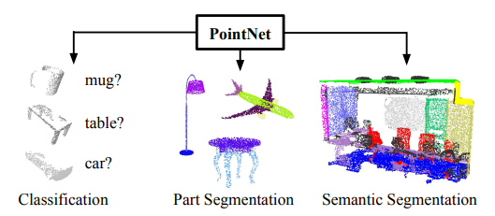
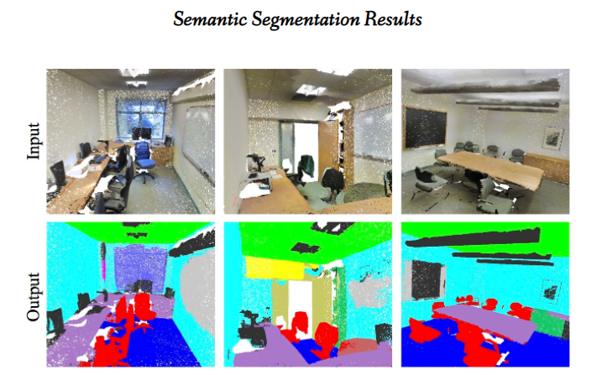
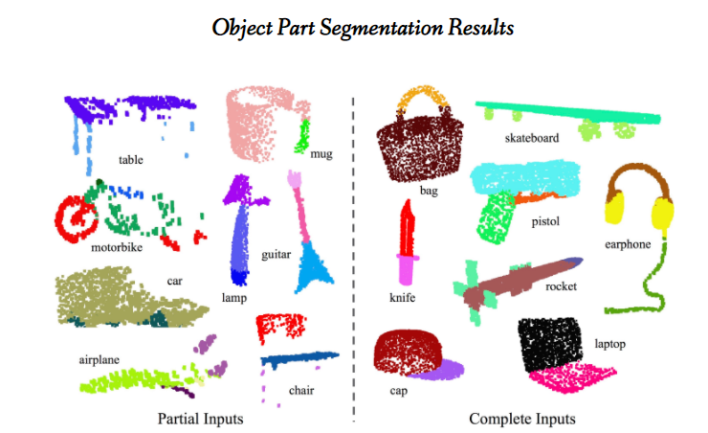
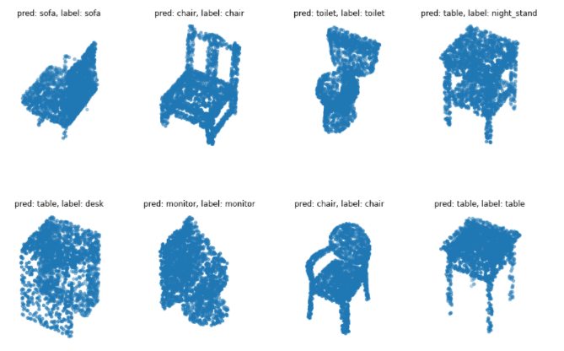
Pointnet
Usage of Pointnet

Slide 15

Exploration
Current Solution
Implementation of Pointnet Architecture using Keras and easily trainable in your local machine.
GitHub Repo Link: https://github.com/ManashJKonwar/IP-Pointnet
Proper Readme level documentation.
Understand Dash and how any project can be structured in dash following code standards.
Implementation Status
Implementation of Pointnet Classifier
Implementation of Pointnet Part Segmenter
Implementation of Pointnet Semantic Segmenter

Slide 16
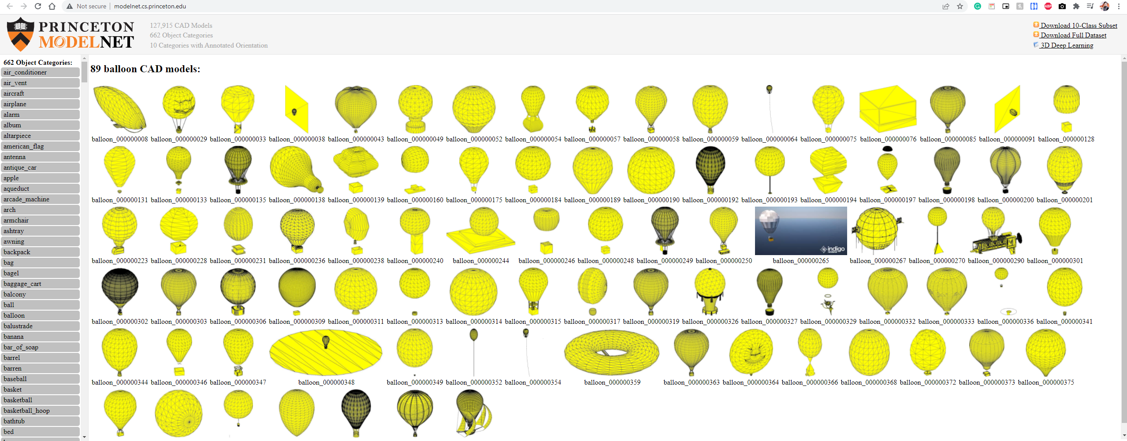
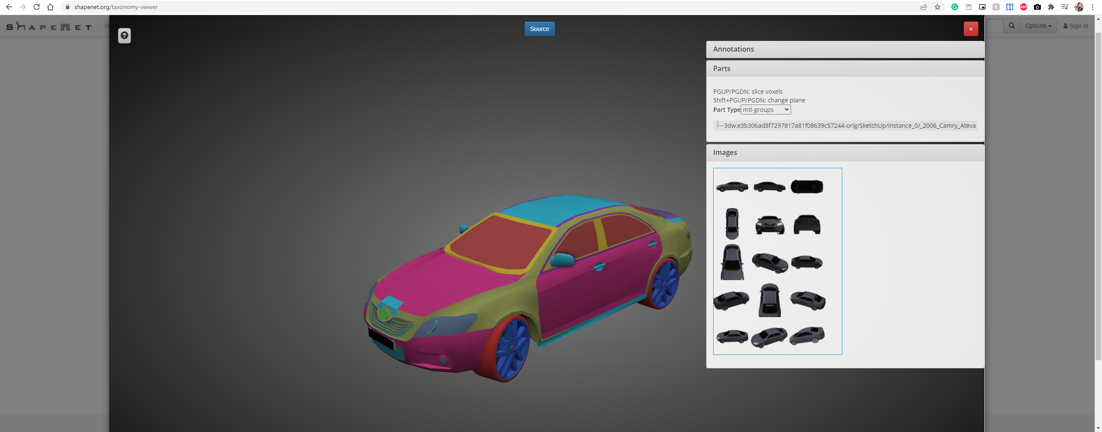
Exploration
Datasets Utilized
PointNet Classifier Credit goes to ModelNet 10 dataset which contains CAD Models from 10 common categories. This is a subset of ModelNet 40 dataset. Each of the point under each object category consist of labelling as to which object category it belongs, and this information helps us greatly to perform training as well as validation runs.
Pointnet Part Segmenter Credit goes to ShapeNet dataset. Its an ongoing effort to establish a richly-annotated, large-scale dataset of 3D shapes. ShapeNetCore is a subset of the full ShapeNet dataset with clean single 3D models and manually verified category and alignment annotations. It covers 55 common object categories, with about 51,300 unique 3D models. I have utilized only 12 object categories of PASCAL 3D+, included as part of the ShapenetCore dataset and each of this category contains part level labelling for perform training as well as validation runs

Slide 17
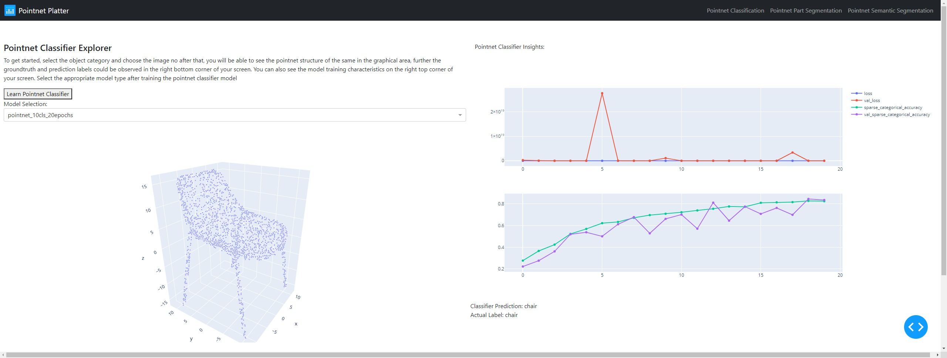
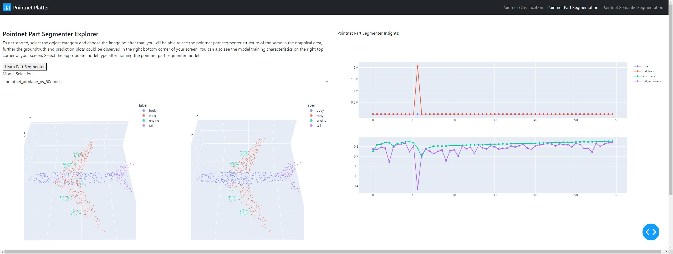
Exploration
Dash Integration
Once Model training is complete, inferencing can be done by using the dash web application build to support Pointnet Classifier and Part Segmenter test datasets.
Model Characteristics can be observed separately.
On top of this, inferencing is performed based on user selections.
“Learn More” Section helps you to understand the underlying concepts.

Slide 18
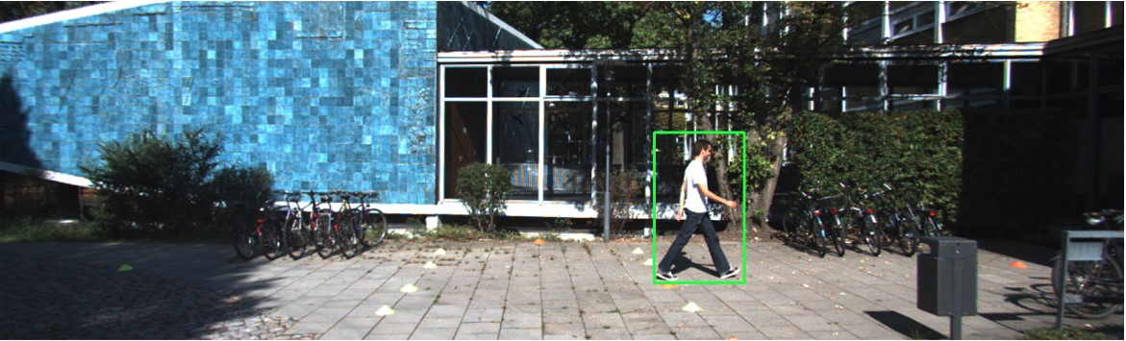
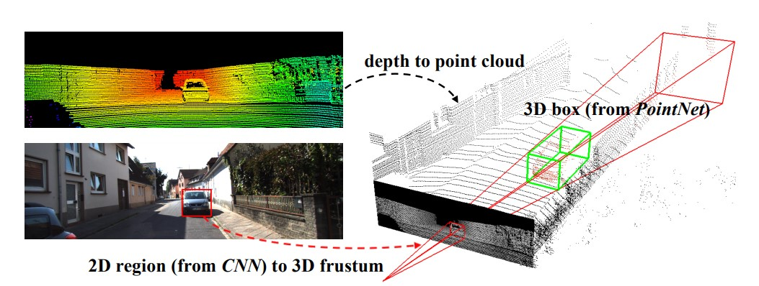
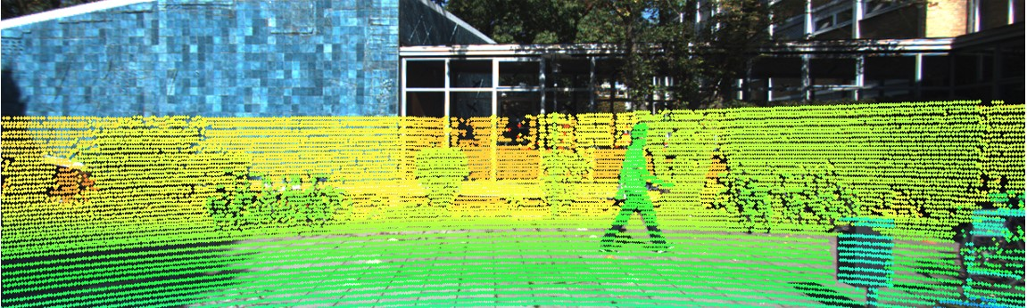
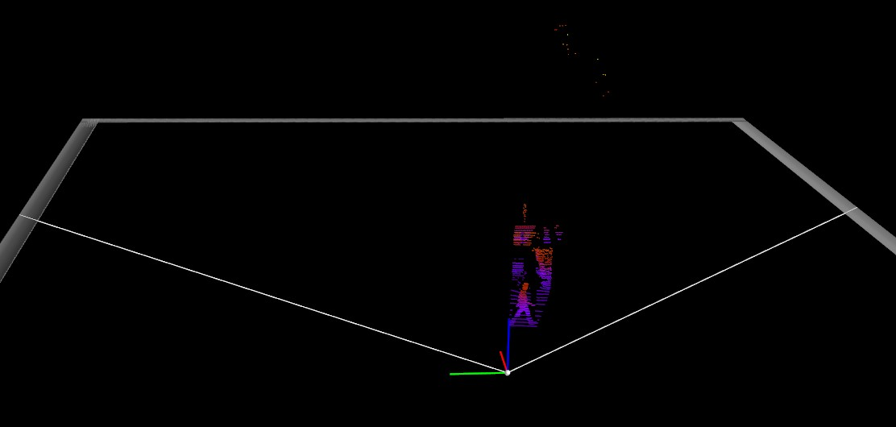
Next Steps
Frustum Pointnet/ Voxel Pointnet
3d Object Detection using Frustum Pointnet using popular KITTI and LYFT Dataset
GitHub Repo Link: https://github.com/ManashJKonwar/IP-Pointnet-ObjectDetection

Slide 19
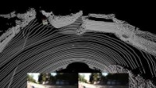

Next Steps
Real time 3d Object Detection

Slide 20
Next Steps
Important Links
Current Code Links:
Pointnet Implementation: https://github.com/ManashJKonwar/IP-Pointnet
Frustum Pointnet Implementation: https://github.com/ManashJKonwar/IP-Pointnet-ObjectDetection
Original Research:
Pointnet: https://arxiv.org/pdf/1612.00593.pdf
Frustum Pointnet Implementation: https://arxiv.org/pdf/1711.08488.pdf
Original Source Code:
Pointnet: https://github.com/charlesq34/pointnet
Frustum Pointnet Implementation: https://github.com/charlesq34/frustum-pointnets

Slide 21
Thank you all !!! Hope you learnt something new ☺ Q & A Session (if any)

